Slide 1
PREDICTING BITCOIN CLOSING PRICE
FCMB_Team2
By: Dashini, Ishita & Aditi

Slide 2
TABLE OF CONTENTS
03
01
04
02
Introduction
Machine Learning
EDA
Conclusion
Notes:
This is just an overview of what we will be covering today.

Slide 3
01
Introduction
Notes:
Let’s begin with our introduction.

Slide 4

Introduction
Bitcoin's volatile price attracts investors and analysts, who seek to predict its trends for informed decision-making in the cryptocurrency market.
Notes:
In recent years, Bitcoin's emergence as a significant financial asset has garnered attention from investors, traders, and analysts due to its volatile price nature, offering opportunities and challenges for profit and risk management in the cryptocurrency market. Predicting Bitcoin price trends accurately is crucial for informed decision-making by traders and investors.

Slide 5
Problem Statement
Developing a machine learning model to predict Bitcoin's future trend based on historical data and relevant indicators over an 8-year period.
Notes:
To meet this demand, this project endeavors to create a machine learning model for forecasting Bitcoin trends (increase, decrease, or stability) over the next period, leveraging 8 years (2015-2024) of historical price data and pertinent indicators.

Slide 6
Dataset
Comprehensive analysis of Bitcoin price dynamics over 8 years with key indicators enables accurate future market trend prediction.
Notes:
This dataset provides a comprehensive analysis of Bitcoin's price dynamics over the past eight years, including daily opening, highest, lowest, and closing prices, trading volume, momentum indicators (RSI), trend indicators (CCI), moving averages (SMA, EMA), and volatility indicators (MACD, Bollinger Bands, True Range, ATR), facilitating the prediction of future market movements by forecasting the closing price for the following day.

Slide 7
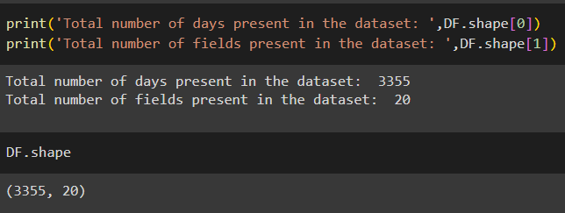
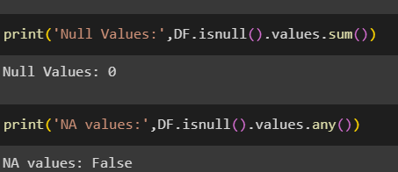
DATASETS
3355 observations, 20 variables, no null or NA values;
Notes:
After importing libraries and data, a glimpse reveals 3355 observations, 20 variables, all non-null, necessitating no removal.To gain deeper insights, Exploratory Data Analysis (EDA) will be conducted.

Slide 8
02
EDA

Slide 9
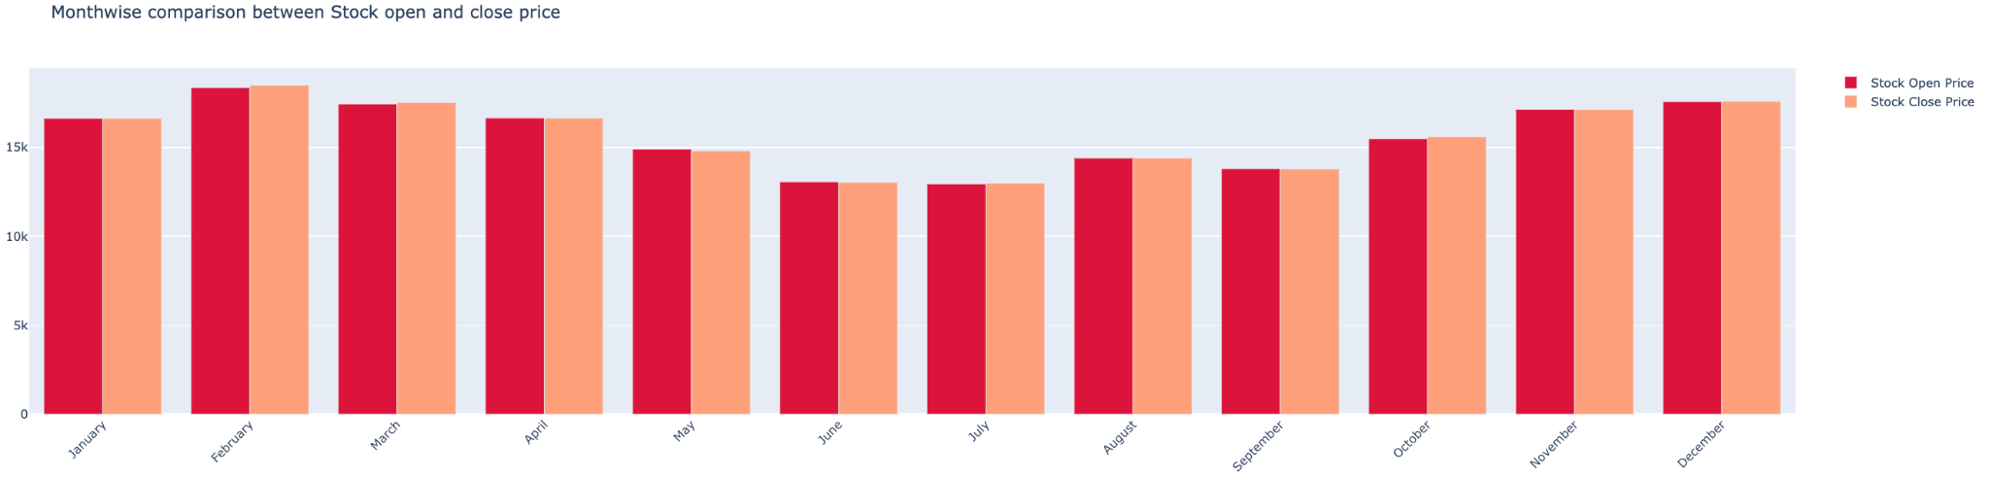
Exploratory Data Analysis
1. Stable monthly open and close prices with slight fluctuations, notable increase in October followed by minor decreases in November and December.
Notes:
Monthly open and close prices remained relatively stable throughout the year, with slight fluctuations observed, while October saw a significant increase followed by slight decreases in November and December.

Slide 10
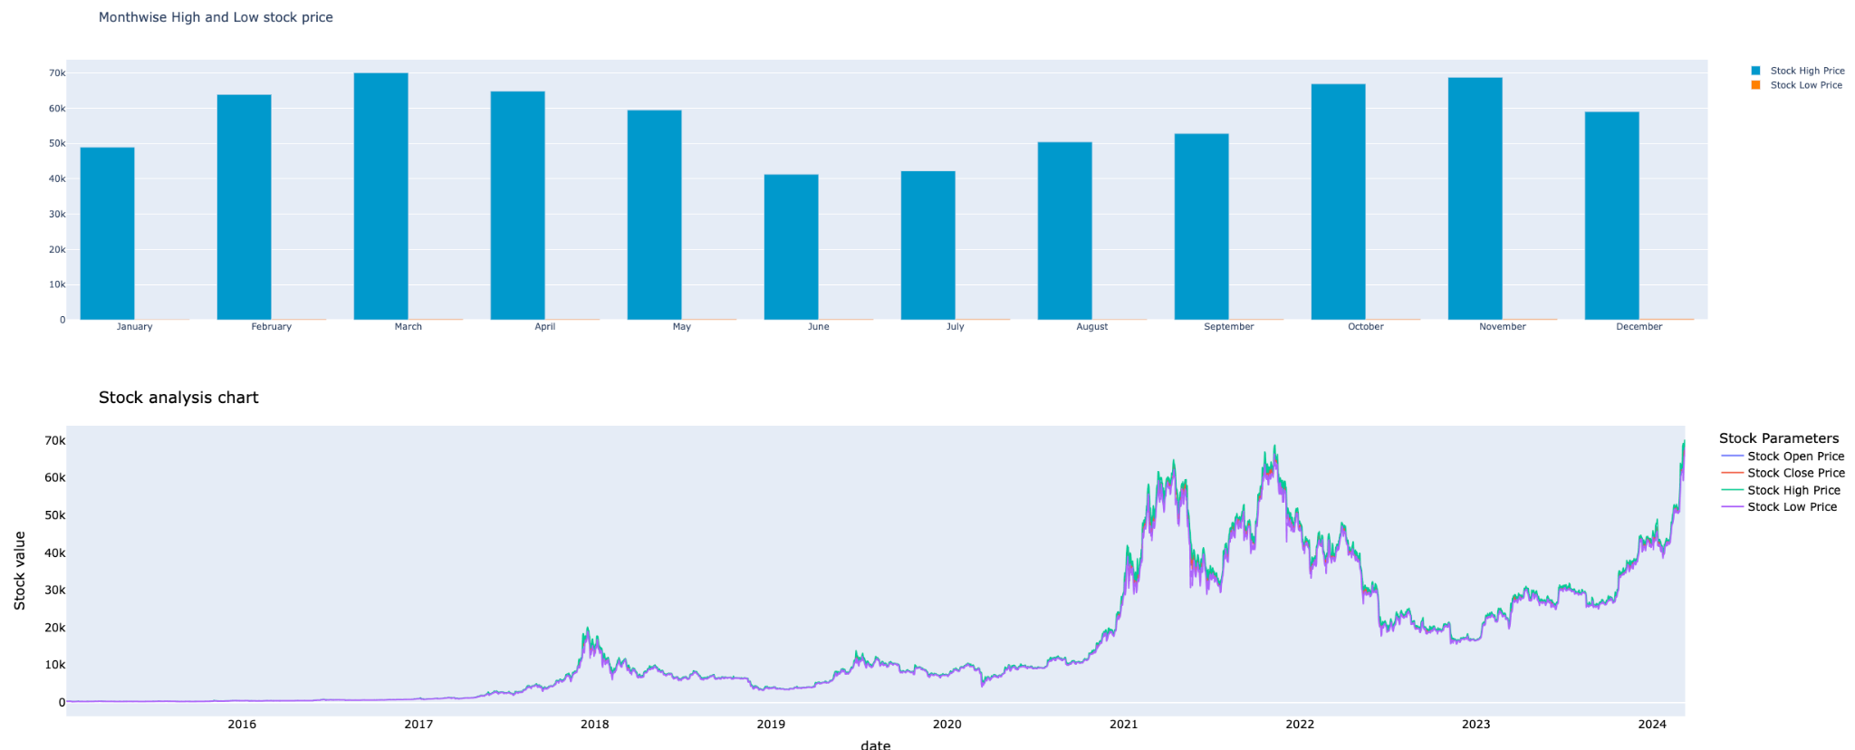
Exploratory Data Analysis
2. Stock prices saw a steady rise from January to March, a slight dip in April, followed by fluctuations, a significant increase in October, and minor decreases in November and December, with open and close prices remaining stable, suggesting overall market stability.
Notes:
Throughout the year, the high and low stock prices exhibited varying trends. From January to March, there was a consistent increase, followed by a decrease in April, although prices remained relatively high. Subsequent months saw fluctuations, with August being relatively stable compared to July. September witnessed a decrease, while October experienced a significant increase. However, November and December saw slight decreases compared to the previous month. Despite this volatility, open and close prices generally remained stable, indicating overall market stability. These insights provide investors with valuable information to make informed decisions regarding their stock investments.

Slide 11
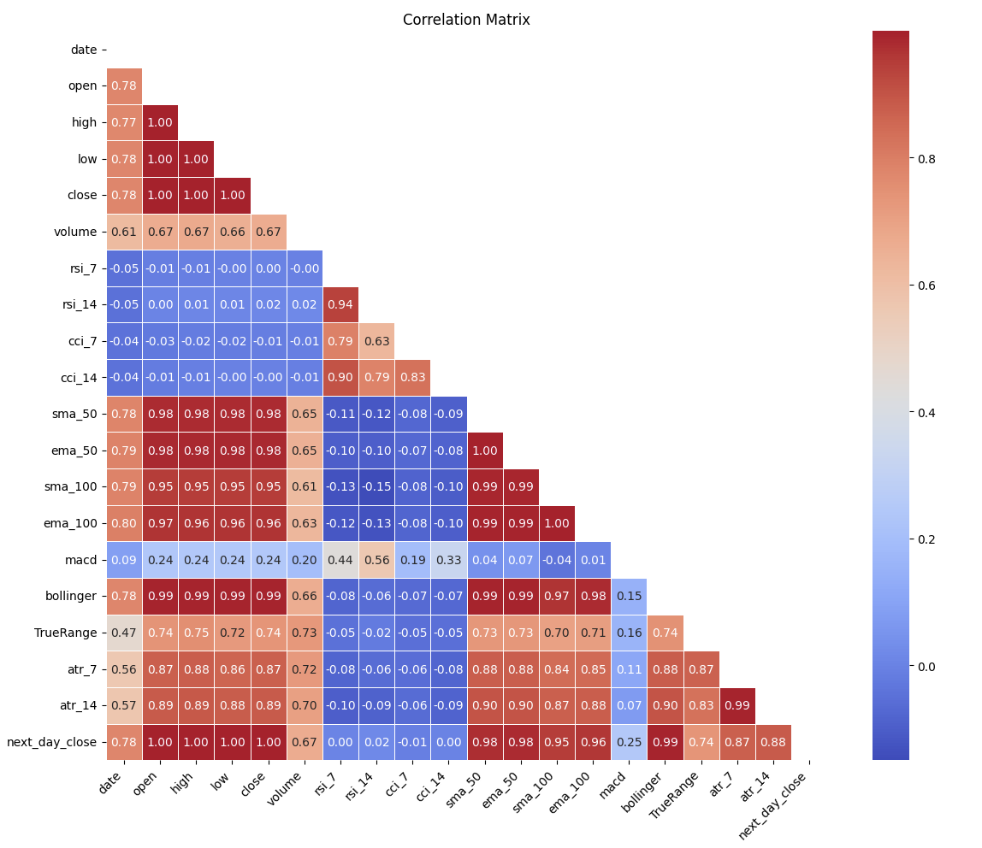
Exploratory Data Analysis
.
Correlation Analysis Using Heatmap
Key Findings:
Strong positive correlations between the open, close, high, and low prices.
Correlation between price and volume was weak, suggesting that trading volume alone may not be a reliable indicator of price movements.
Notes:
These observations highlight the strong interdependencies among the stock parameters, particularly between the open, close, high, and low prices. Understanding these correlations can be valuable for stock analysis and prediction models.

Slide 12
Exploratory Data Analysis
.
C
Data Preprocessing
Normalized data using MinMaxScaler
Removed outliers utilizing z-score method and the IQR method.
Identified outliers in 'volume', 'open', and 'close' columns that significantly deviate from the norm.
Once we identified the outliers, the code removes them from the original dataframe, resulting in a new dataframe without outliers.
Notes:
In the data preprocessing stage, outliers were identified and removed to enhance the dataset's representativeness. Subsequently, the close price data was normalized using the MinMaxScaler technique, ensuring all values fall within a common range (typically 0 to 1). Normalization facilitates fair comparison and analysis, particularly valuable when dealing with features of different scales. This process prepares the close price data for modeling, ensuring equal contribution of all features in predictive analysis, such as Bitcoin price prediction.

Slide 13
03
Machine Learning
Notes:
Upon completing preprocessing, we need to do machine learning with the various machine learning models

Slide 14
Prepare Dataset for Training
splitting the data into training and testing sets, with 60% for training and 40% for testing.
Notes:
Prior to training the machine, it is important to split the data into training and testing sets and we have set 60% for training and 40% for testing

Slide 15
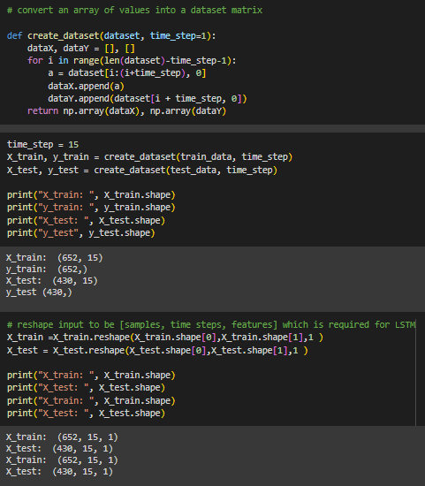
LSTM
Transform to time-series data
Define create_dataset to format time-series data.
Notes:
In time-series analysis, transforming close prices into input-output pairs with a time window, like 15 time steps, is crucial for LSTM modeling. The create_dataset function structures raw data for training, capturing temporal dependencies and aiding pattern recognition. A 15-time step window enables the model to access historical information, aligning with sequential data's nature and emphasizing historical context's importance in accurate forecasting.

Slide 16
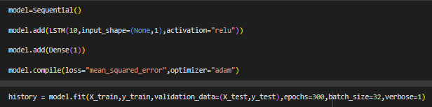
LSTM
LSTM Model Training and Evaluation
Sequential model with LSTM, Dropout, Dense layers.Compile model with Adam optimizer, MSE loss, train.
Notes:
This structured LSTM modeling approach for time series analysis includes defining architecture, training over 300 epochs with batch size 32, using MSE loss, Adam optimizer, visualizing progress, generating predictions for training/testing datasets, and evaluating performance with metrics like RMSE, MSE, MAE, explained variance, R2 score, MGD, and MPD. This ensures effective pattern learning and precise forecasting, showcasing a holistic LSTM modeling strategy.

Slide 17
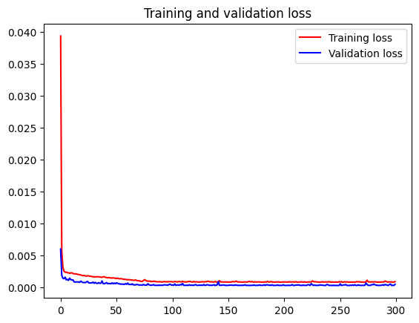
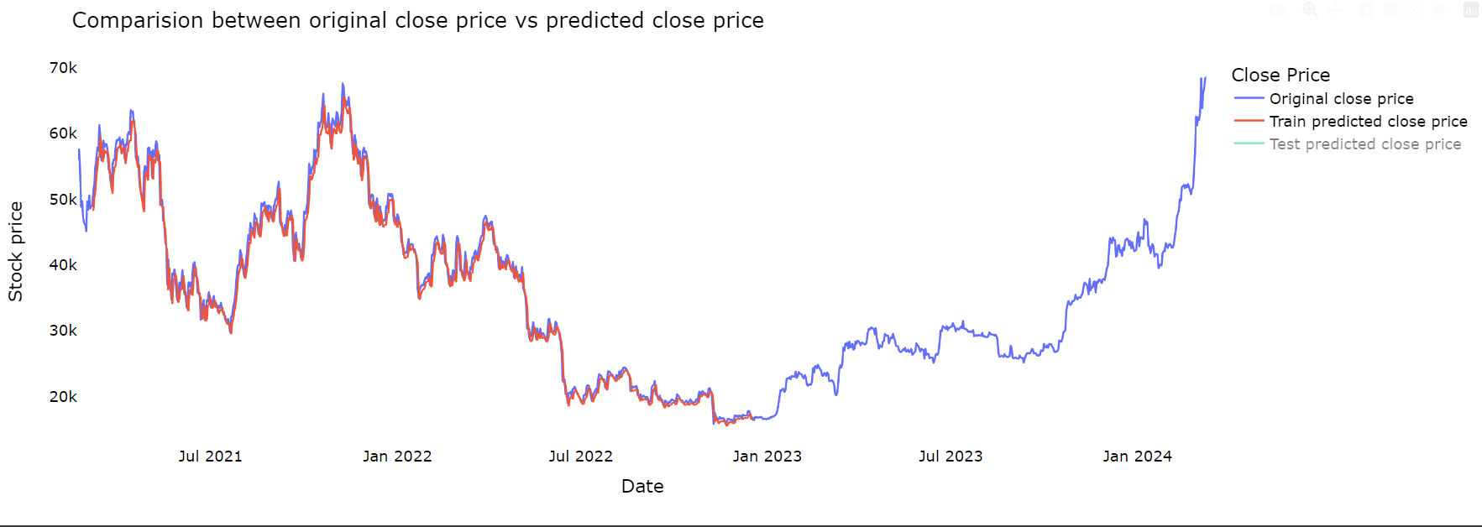
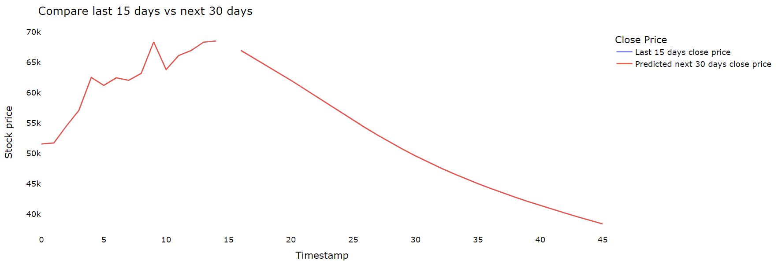
LSTM
Visualization
A comprehensive analysis of close prices and forecasting performance of the model.
Notes:
In the following few slides, Using Plotly Express, we visualize original and predicted close prices, forecast future close prices, and plot the entire dataset with predictions to analyze the LSTM model's performance and forecasting abilities.

Slide 18
LSTM
Training and Validation Loss
Model effectively learns, generalizes; not overfitting.
Notes:
The training loss initially decreases rapidly, reaching a minimum after around 100 epochs, while the validation loss decreases at a slower pace, hitting a minimum after about 150 epochs. Both losses then stabilize, with slight fluctuations. The close proximity of training and validation losses suggests effective learning and generalization without overfitting. Overall, the model demonstrates effective learning from training data and generalization to unseen data, indicating its potential for accurate predictions.

Slide 19
LSTM
Comparison between original close price vs predicted close price
LSTM model captures trends, some discrepancies expected. Train predictions align better than test.
Notes:
The plot compares original and predicted close prices from a trained LSTM model, revealing alignment in overall trend but discrepancies in short-term fluctuations. Train predictions closely match the original data, while test predictions show slight divergence, highlighting the model's potential for stock price forecasting with a focus on trend capture and short-term limitations.

Slide 20
LSTM
Compare last 15 dats vs next 30 days
The predicted next 30 days close price shows a potential upward trend compared to the last 15 days close price.
Notes:
The predicted close prices for the next 30 days suggest a potential upward trend in the stock's price, with a gradual increase over time. This information can be useful for investors and traders looking for potential trading opportunities based on predicted price movements.

Slide 21
REGRESSION MODELS
LINEAR REGRESSION
POLYNOMIAL REGRESSION
RIDGE REGRESSION
Notes:
Next, we will be covering the following regression models

Slide 22
Transform data
Transform data to regression modelling dataset
Notes:
The dataset is initially prepared for time series forecasting using a machine learning model like LSTM and not regression, so transformation is done to effectively removes the time series structure from the data, converting it into a tabular format that can be used for regression modeling.

Slide 23
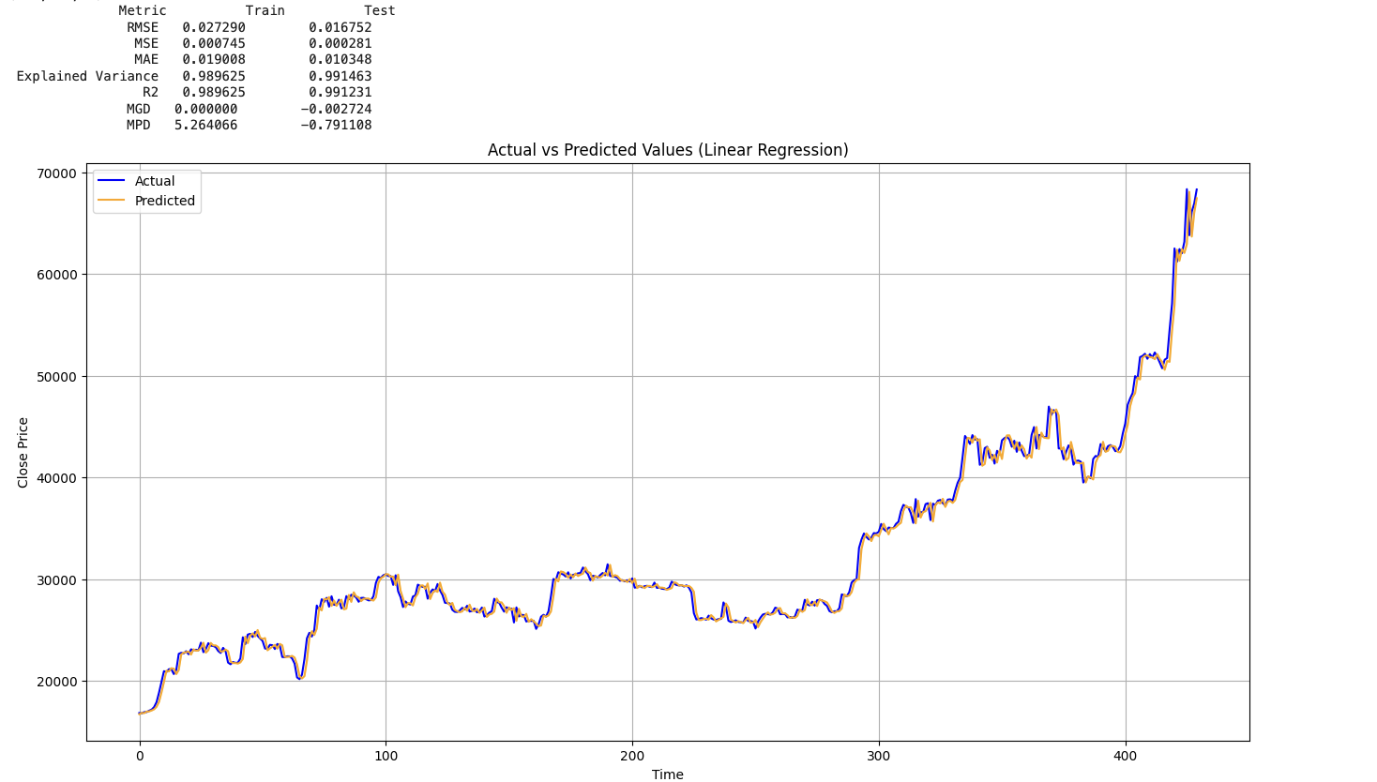
LINEAR REGRESSION
Notes:
The linear regression model exhibits low RMSE, MSE, and MAE values, indicating accurate predictions with high explained variance and R2 scores. While MGD values are close to zero, the model shows slightly higher mean percentage errors for individual predictions in the training dataset. Overall, it demonstrates strong predictive capability but with some larger percentage errors on individual predictions, particularly in the training data.

Slide 24
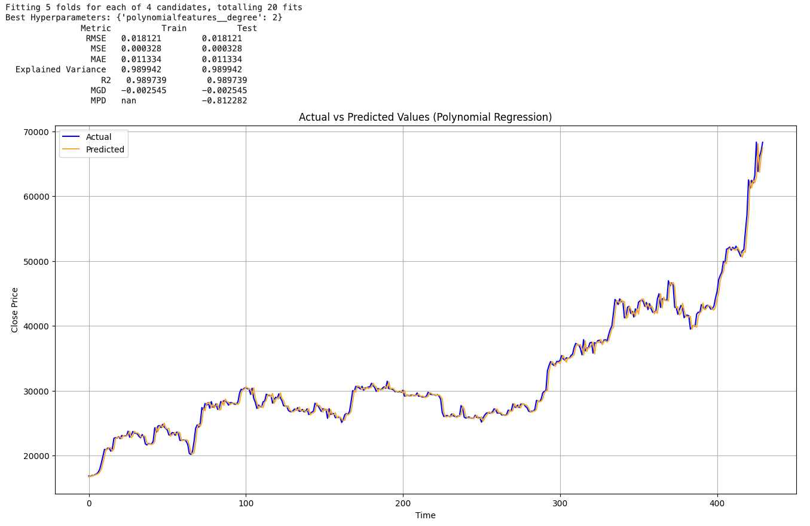
POLYNOMIAL REGRESSION
Notes:
The polynomial regression model with the optimal degree of 2 exhibits exceptional performance, as evidenced by extremely low RMSE, MSE, and MAE values, high explained variance and R2 scores, and strong generalization to unseen data. Overall, it accurately captures underlying patterns and demonstrates outstanding predictive capabilities.

Slide 25
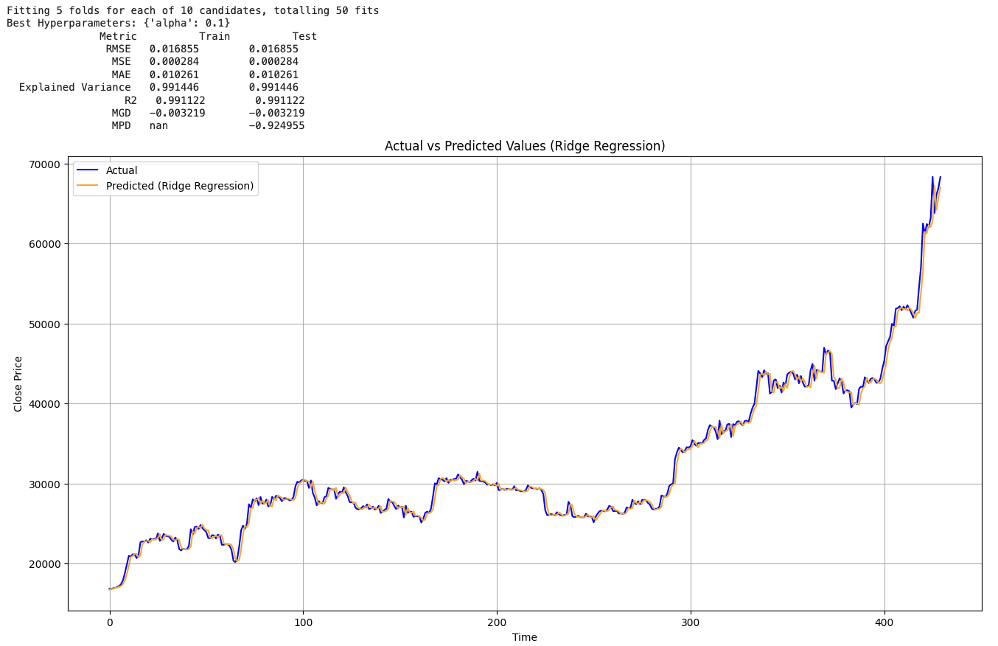
RIDGE REGRESSION
Notes:
The Ridge regression model with alpha=0.1 achieves exceptional accuracy with low RMSE and MSE, minimal MAE, and high explained variance and R2 score, indicating precise capture of data patterns. Despite a small MPD, it demonstrates outstanding performance, making it a reliable choice for accurate predictions.

Slide 26
CLASSIFICATION MODELS
DECISION TREE CLASSIFIER
NAIVES BAYES
SVM
Notes:
Next, we will cover the classification models

Slide 27
Transform data
Transform data to discrete classes
Notes:
In time series forecasting, the target variable is usually the next value in the sequence, while for classification tasks, discrete classes or categories are required. To adapt time series data for classification models, the target variable (e.g., Bitcoin prices) must be transformed into discrete classes or categories. This can involve binning prices into intervals or categorizing based on criteria like price direction (increase, decrease, or remain stable).

Slide 28
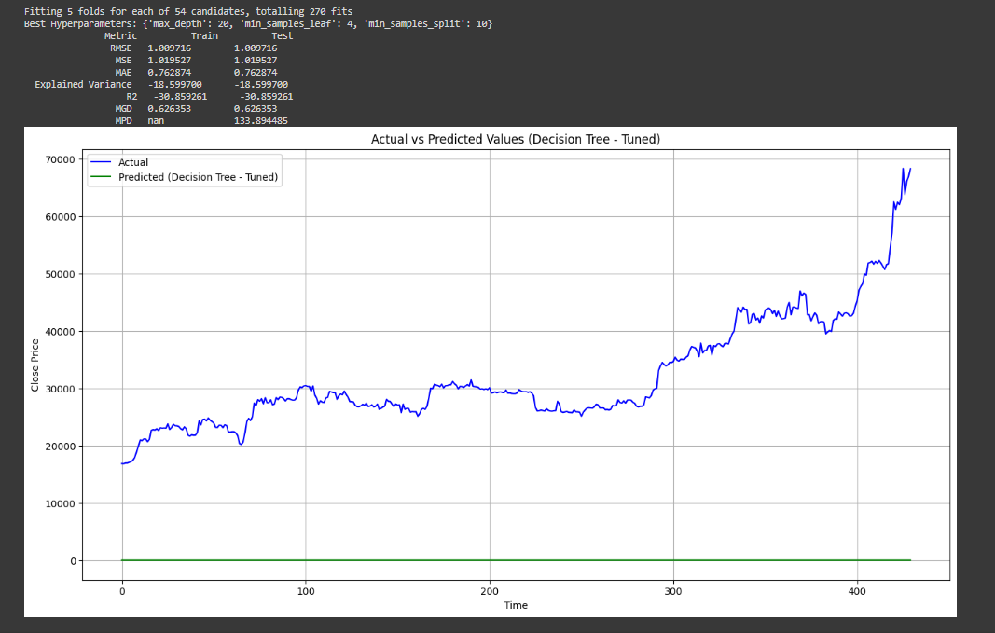
DECISI0N TREE
Notes:
The Decision Tree Classifier's performance, evaluated with various metrics, reveals significant shortcomings. Both training and test sets show high RMSE, MSE, and MAE values, along with negative explained variance and R-squared scores, indicating poor fit to the data. The model exhibits a high mean percentage difference (MPD) of approximately 133.8945, suggesting significant deviations between predicted and actual values. Overall, the model fails to capture underlying patterns and requires further analysis or alternative approaches for improvement.

Slide 29
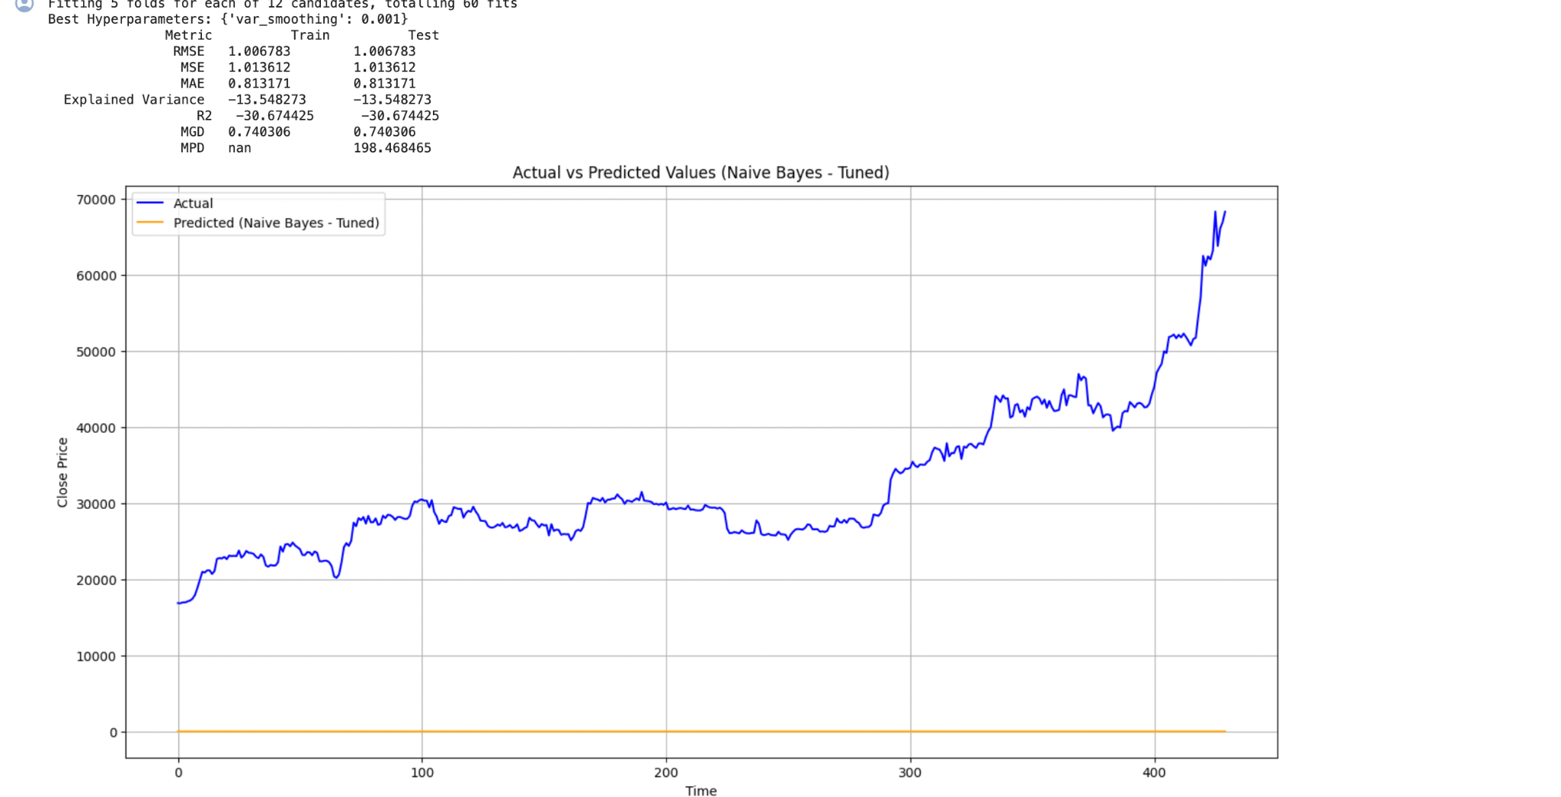
NAIVES BAYES
Notes:
For Naive Bayes, The grid search explored 12 hyperparameter candidates with 5-fold cross-validation, identifying var_smoothing=0.001 as the best parameter. However, the model's performance is notably poor, with negative explained variance and R2 scores, and high MPD indicating significant deviation of predicted values from actual values, particularly on the test data.

Slide 30
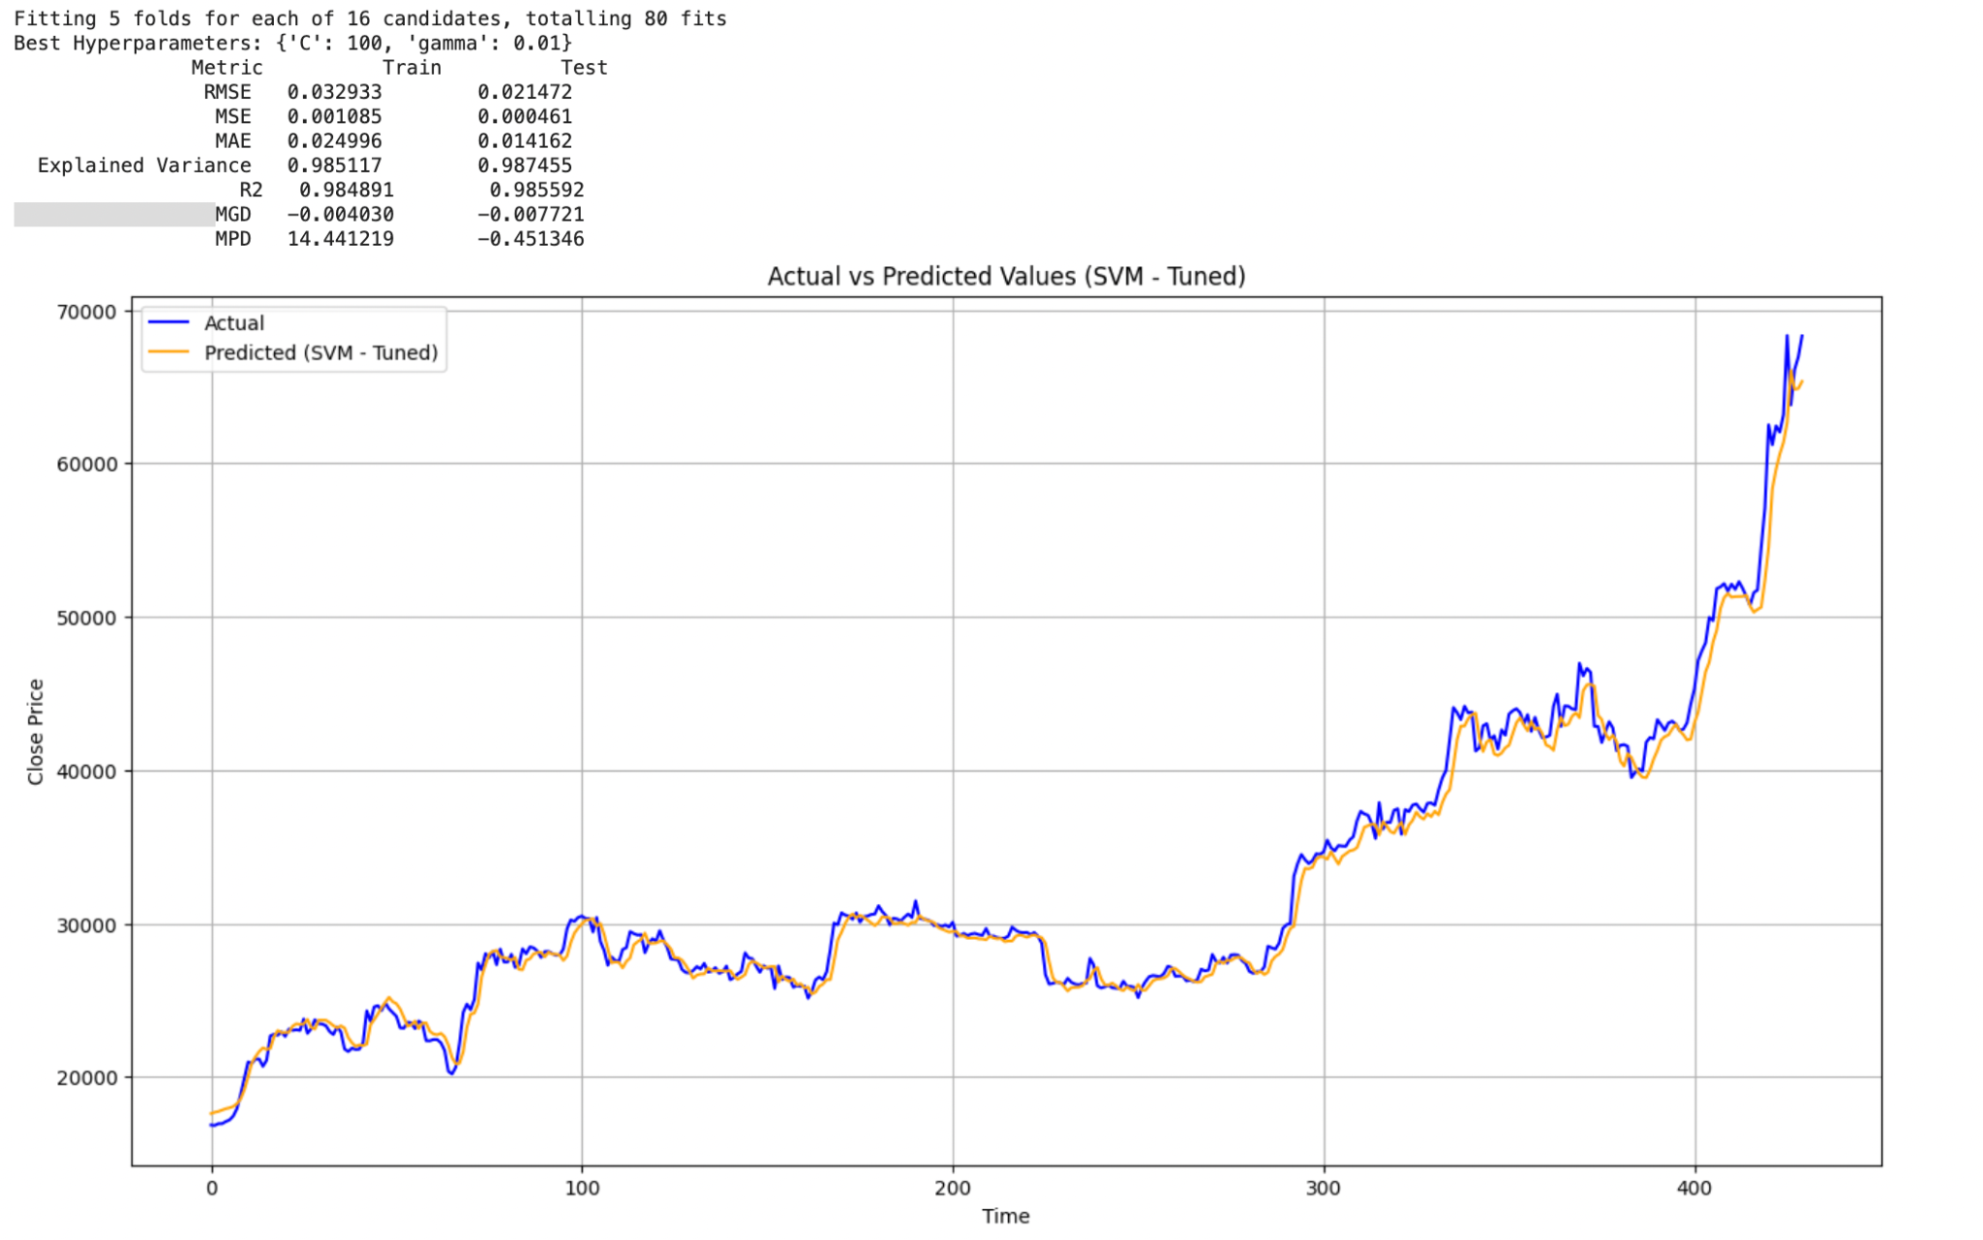
SVM
Notes:
The grid search explored 16 combinations with 5-fold cross-validation, yielding optimal hyperparameters of C=100 and gamma=0.01. The SVM model exhibits strong performance with low RMSE, MSE, and MAE, high explained variance and R2 score, indicating excellent generalization and accuracy. Despite a negative MGD, the model slightly underestimates the target variable, while the MPD, particularly for training data, suggests higher average deviation. Overall, the SVM model demonstrates robustness and effectiveness in capturing data patterns and making predictions.

Slide 31
04
Conclusion

Slide 32
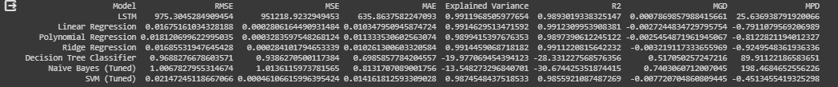
EVALUATE MODEL
LSTM IS THE BEST MODEL
Notes:
After evaluating various machine learning models for Bitcoin price prediction using common evaluation metrics such as RMSE, MSE, MAE, Explained Variance, R2, Mean Gamma Deviance (MGD), and Mean Poisson Deviance (MPD), LSTM emerges as the optimal choice. Its capacity to handle time series data, capture long-term dependencies, model non-linear relationships, and manage large datasets makes it particularly effective for predicting Bitcoin price trends over an 8-year period. Additionally, LSTM's robustness in handling noise further solidifies its suitability for this task. Therefore, LSTM stands out as the preferred model for accurate and reliable Bitcoin price forecasting.

Slide 33
THANKS!
Please keep this slide for the attribution

